Slide 1
Big Mountain Resort Ticket Price Predictive Model
Problem Statement
We suspect we may not be maximizing returns, relative to our position in the market. We also does not have a strong sense of what facilities matter most to visitors, particularly which ones they're most likely to pay more for.
This project will build a predictive model for ticket price based on a number of facilities, or properties, boasted by resorts (at the resorts). This model will be used to provide guidance for Big Mountain's pricing and future facility investment plans.

Slide 2
Big Mountain Resort Ticket Price Predictive Model
Recommendation
Big Mountain currently has a ticket price of 81 dollars. Analysis leads us to believe that due to the 2353 vertical drop, 3 fastquads, 3000 acres of skiable terrain, and 600 acres of night skiing, we can increase the ticket price to 95 dollars. Additionally, adding a new run which increases our vertical drop by 150 feet will allow an additional 1.99 dollar increase.

Slide 3
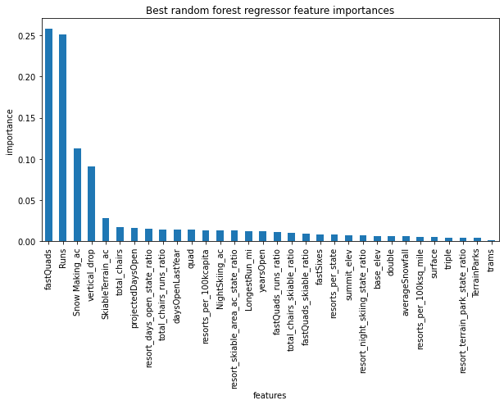
Big Mountain Resort Ticket Price Predictive Model
Modeling Results
Random Forest was the model selected because it had the least variability and least mean absolute error versus Linear Regression and using the Mean.
The top four features for determining ticket price are:
fastQuads
Runs
Snow Making_ac
vertical_drop

Slide 4
Big Mountain Resort Ticket Price Predictive Model
Summary
Big Mountain currently has a ticket price of 81 dollars. Analysis leads us to believe that due to the 2353 vertical drop, 3 fastquads, 3000 acres of skiable terrain, and 600 acres of night skiing,
We can increase the ticket price to 95 dollars. Additionally, adding a new run which increases our vertical drop by 150 feet will allow an additional 1.99 dollar increase.

